Slide 1
Verifying LLM-powered Code Transformations with Equivalence Checking
Solidity Language Summit
John Toman
November 2025

Slide 2
Agenda
Background & Motivation
Concordance: In Brief
Defining Equivalence
Checking Equivalence
Concordance: The Details

Slide 3
Background & Motivation

Slide 4



A brief digression…
Certora Prover is our “flagship” technology
Verifies smart contracts written in Solidity (& others)
Relies on static analysis of memory, storage, etc.
.VY
vyper
.WASM
rustc
Report
.RS
.EVM
Decompile
.SBF
rustc
.SOL
solc
.TAC
Static
Analysis
VC generation
SMT Solver
Analyze
.SMT2
Bug
SPEC CVL/CVLR
Compile

Slide 5
Analysis Kryptonite
Solidity’s frequently (ab)used feature: Inline assembly!
Frequently causes issues with critical static analyses
assembly {
mstore(
add(mload(0x0),
sload(calldataload(0x4))),
calldataload(0x24))
}

Slide 6

Motivating Example: Solady
function safeTransferFrom(
address token,
address from,
address to,
uint256 amount
) internal {
assembly {
let m := mload(0x40)
mstore(0x60, amount)
mstore(0x40, to)
mstore(0x2c, shl(96, from))
mstore(0x0c, 0x23b872dd000000000000000000000000)
let success := call(gas(), token, 0, 0x1c, 0x64, 0x00, 0x20)
if iszero(and(eq(mload(0x00), 1), success)) {
if iszero(
lt(
or(iszero(extcodesize(token)), returndatasize()),
success
)
) {
mstore(0x00, 0x7939f424)
revert(0x1c, 0x04)
}
}
mstore(0x60, 0)
mstore(0x40, m)
}
}
Representative example of Solady code
Heavily optimized, gas efficient
… and absolutely galaxy brain

Slide 7
Motivating Example: Solady (cont)
function safeTransferFrom(
address token,
address from,
address to,
uint256 amount
) internal {
assembly {
let m := mload(0x40)
mstore(0x60, amount)
mstore(0x40, to)
mstore(0x2c, shl(96, from))
mstore(0x0c, 0x23b872dd000000000000000000000000)
let success := call(gas(), token, 0, 0x1c, 0x64, 0x00, 0x20)
if iszero(and(eq(mload(0x00), 1), success)) {
if iszero(
lt(
or(iszero(extcodesize(token)), returndatasize()),
success
)
) {
mstore(0x00, 0x7939f424)
revert(0x1c, 0x04)
}
}
mstore(0x60, 0)
mstore(0x40, m)
}
}
Representative of a lot of modern DeFi code
Absolutely kills some of our static analyses…
… not easy to audit either

Slide 8
Motivation
function safeTransferFrom(
address token,
address from,
address to,
uint256 amount
) internal {
assembly {
let m := mload(0x40)
mstore(0x60, amount)
mstore(0x40, to)
mstore(0x2c, shl(96, from))
mstore(0x0c, 0x23b872dd000000000000000000000000)
let success := call(gas(), token, 0, 0x1c, 0x64, 0x00, 0x20)
if iszero(and(eq(mload(0x00), 1), success)) {
if iszero(
lt(
or(iszero(extcodesize(token)), returndatasize()),
success
)
) {
mstore(0x00, 0x7939f424)
revert(0x1c, 0x04)
}
}
mstore(0x60, 0)
mstore(0x40, m)
}
}
Can we automatically generate “equivalent” implementations?
(for auditing, code review, analysis …)
?

Slide 9
Motivation
function safeTransferFrom(
address token,
address from,
address to,
uint256 amount
) internal {
assembly {
let m := mload(0x40)
mstore(0x60, amount)
mstore(0x40, to)
mstore(0x2c, shl(96, from))
mstore(0x0c, 0x23b872dd000000000000000000000000)
let success := call(gas(), token, 0, 0x1c, 0x64, 0x00, 0x20)
if iszero(and(eq(mload(0x00), 1), success)) {
if iszero(
lt(
or(iszero(extcodesize(token)), returndatasize()),
success
)
) {
mstore(0x00, 0x7939f424)
revert(0x1c, 0x04)
}
}
mstore(0x60, 0)
mstore(0x40, m)
}
}
Can we automatically generate “equivalent” implementations?
?

Slide 10
Concordance: In Brief

Slide 11
Motivation
function safeTransferFrom(
address token,
address from,
address to,
uint256 amount
) internal {
assembly {
let m := mload(0x40)
mstore(0x60, amount)
mstore(0x40, to)
mstore(0x2c, shl(96, from))
mstore(0x0c, 0x23b872dd000000000000000000000000)
let success := call(gas(), token, 0, 0x1c, 0x64, 0x00, 0x20)
if iszero(and(eq(mload(0x00), 1), success)) {
if iszero(
lt(
or(iszero(extcodesize(token)), returndatasize()),
success
)
) {
mstore(0x00, 0x7939f424)
revert(0x1c, 0x04)
}
}
mstore(0x60, 0)
mstore(0x40, m)
}
}
Can we automatically generate “equivalent” implementations?
?

Slide 12
“AI powered”
Is it this simple?
Any available LLM
function safeTransferFrom(
address token,
address from,
address to,
uint256 amount
) internal {
assembly {
let m := mload(0x40)
mstore(0x60, amount)
mstore(0x40, to)
mstore(0x2c, shl(96, from))
mstore(0x0c, 0x23b872dd000000000000000000000000)
let success := call(gas(), token, 0, 0x1c, 0x64, 0x00, 0x20)
if iszero(and(eq(mload(0x00), 1), success)) {
if iszero(
lt(
or(iszero(extcodesize(token)), returndatasize()),
success
)
) {
mstore(0x00, 0x7939f424)
revert(0x1c, 0x04)
}
}
mstore(0x60, 0)
mstore(0x40, m)
}
}
function safeTransferFrom(
address token,
address from,
address to,
uint256 amount
) internal {
(bool success, bytes memory returndata) =
token.call(
abi.encodeWithSelector(
0x23b872dd, from, to, amount
)
);
// ...
}
🤖
“Please rewrite the following code to use standard solidity instead of inline assembly. Make sure it’s equivalent …”

Slide 13




Concordance: “AI powered”
(original)
(simplified)
.SOL
LLM
Is it this simple?
.SOL
Prompt
“Please simplify the following code …”

Slide 14
“AI powered” … mistakes
Proposed rewrite by Claude
function safeTransferFrom(
address token,
address from,
address to,
uint256 amount
) internal {
assembly {
let m := mload(0x40)
mstore(0x60, amount)
mstore(0x40, to)
mstore(0x2c, shl(96, from))
mstore(0x0c, 0x23b872dd000000000000000000000000)
let success := call(gas(), token, 0, 0x1c, 0x64, 0x00, 0x20)
if iszero(and(eq(mload(0x00), 1), success)) {
if iszero(
lt(
or(iszero(extcodesize(token)), returndatasize()),
success
)
) {
mstore(0x00, 0x7939f424)
revert(0x1c, 0x04)
}
}
mstore(0x60, 0)
mstore(0x40, m)
}
}
function safeTransferFrom(
address token,
address from,
address to,
uint256 amount
) internal {
(bool success, bytes memory returndata) = token.call(
abi.encodeWithSelector(0x23b872dd, from, to, amount)
);
// Check if the call succeeded and returned true (1)
if (success && returndata.length >= 32 && abi.decode(returndata, (bool))) {
return;
}
// Allow calls to contracts that don't return values (non-standard tokens)
if (success && token.code.length > 0 && returndata.length == 0) {
return;
}
// All other cases should revert with TransferFromFailed
revert TransferFromFailed;
}
?

Slide 15



Concordance: AI powered … with guardrails
(original)
(original)
.SOL
LLM
.SOL
Concord
Explanation
(simplified)
(simplified)
Prompt
.SOL
Formally verifies whether two contracts are equivalent
.SOL
Concordance

Slide 16
Concordance: AI powered … with guardrails
(original)
(original)
.SOL
LLM
.SOL
Concord
Explanation
(simplified)
(simplified)
Prompt
.SOL
Formally verifies whether two contracts are equivalent
.SOL
Concordance

Slide 17
Defining Equivalence

Slide 18
Intuitive Definition
Two programs are “equivalent” if they “do the same thing” on “the same inputs”.

Slide 19
Intuitive Definition
Two programs are “equivalent” if they “do the same thing” on “the same inputs”.

Slide 20
Intuitive Definition
I
Two programs are “equivalent” if they “produce the same outputs” on “the same inputs”.
P₁
P₂
O
Notes:
“After all, we can declare two 'mathematical' functions to be 'extensionally equal' if they produce the same output values on the same input values”

Slide 21
Formalizing the Definition
Two programs are “equivalent” if they “produce the same outputs” on “the same inputs”.
P₁
P₂
x = y
contract C1 {
function f(uint x) external returns (uint) {
return 2 + x;
}
}
contract C2 {
function f(uint y) external returns (uint) {
return y + 2;
}
}
⇒
2 + x = y + 2
?

Slide 22
Formalizing the Definition (cont)
≝
“the same calldata buffers”
“the same inputs“
≝
“produce the same returndata buffers”
“produce the same outputs“
Notes:
I am including in “returndata buffer” the revert status of the call

Slide 23
Formalizing the Definition (cont)
Two programs are “equivalent” if they “produce the same returndata buffers” on “the same calldata buffers”.
P₁
P₂
x = y
contract C1 {
uint z;
function f(uint x) external returns (uint) {
return z + x;
}
}
contract C2 {
uint w;
function f(uint y) external returns (uint) {
return y + w;
}
}
⇒
z + x = y + w
?

Slide 24
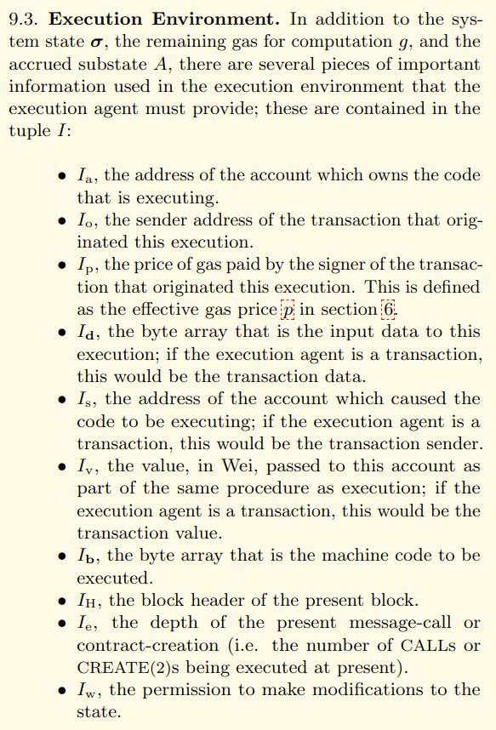
Expanding inputs
Smart contracts “implicitly” receive their current storage, and the state of the rest of the Ethereum blockchain (codehashes, nonces, balances…) as input!

Slide 25
Formalizing the Definition (cont)
≝
“the same calldata buffers AND environment”
“the same inputs“
≝
“produce the same returndata buffers”
“produce the same outputs“

Slide 26
Formal Definition (?)
calldata buffer
environment
(storage, nonces, …)
(I, S)
Two programs are “equivalent” if they “produce the same returndata buffers” on “the same calldata buffers AND environment”.
P₁
P₂
O
Notes:
“After all, we can declare two 'mathematical' functions to be 'extensionally equal' if they produce the same output values on the same input values”

Slide 27
More outputs?
Two programs are “equivalent” if they “produce the same returndata buffers” on “the same calldata buffers AND environment”.
P₁
P₂
contract C1 {
uint public z;
function f(uint x) external {
z = z + x;
}
}
contract C2 {
uint public z;
function f(uint y) external {
z = y + z + 1;
}
}
Why?

Slide 28
More Intuition
An external actor shouldn’t be able to “tell the difference” between two equivalent implementations.
// c1.z
c1.f(5);
c1.z()
= 6 =
// c2.z
c2.f(5);
c2.z()
= 11 ≠ 12 =

Slide 29
More Intuition
An external actor shouldn’t be able to “tell the difference” between two equivalent implementations.
// c1.z
c1.f(5);
c1.z()
= 6 =
// c2.z
c2.f(5);
c2.z()
= 11≠12 =
Side Effects

Slide 30
Defining Side Effects
Mutating Storage
Emitting a log/event
Calling another contract
balance transfers
contract creation
[Self-Destruct]
Pushing/popping the stack
Mutating memory
Why not?

Slide 31
Defining Side Effects
An external actor shouldn’t be able to “tell the difference” between two equivalent implementations.
Stack and memory are not visible to an external actor!
“If the stack gets popped in the forest and no one is around to hear it…”
Notes:
except to the extent that they influence the other side effects.
“Consider the difficulty if we insisted on equivalent stack or memory …”

Slide 32

Gas, Gas, Gas
We also exclude gas!
Definitely an observable side effect!
Would overly restrict space of equivalent programs
Notes:
Consider that the gas costs of an execution are determined by the sequence of opcodes, the reverse is *almost* true. Blah blah blah…

Slide 33
Subtleties
contract C1 {
uint public z;
function f() external{
z = 1;
revert();
}
}
If a function reverts, it has no side effects (by definition)
contract C2 {
uint public z;
function f() external{
revert();
}
}

Slide 34
Subtleties
contract C1 {
address token;
function f() external {
token.transfer(20);
emit Transferred(20);
}
}
If a function reverts, it has no side effects (by definition)
Logs are not observable on-chain, so the interleaving of logs/external calls is not important
contract C2 {
address token;
function f() external {
emit Transferred(20);
token.transfer(20);
}
}

Slide 35
Subtleties
contract C1 {
uint public z;
function f() external{
z = 1;
z = 42;
}
}
If a function reverts, it has no side effects (by definition)
Logs are not observable on-chain, so the interleaving of logs/external calls is not important
We only care about the final state of storage, not intermediate states*
contract C2 {
uint public z;
function f() external{
z = 42;
}
}

Slide 36
Other Definitions
Other reasonable definitions exist!
Require strictly less gas
Require identical interleavings of calls/logs
Equivalent modulo valid calldata
…

Slide 37
Summary: Equivalence
Two contracts/programs are equivalent if, on the same calldata and in the same environment, they both:
Revert with identical returndata buffers, OR
Return with identical returndata buffers and:
Emit the same logs (in the same order)
Make the same external calls (in the same order)
End with equal storages

Slide 38
Next: Formal Verification
…
…
Concord
…
…
Formally verifies whether two contracts are equivalent

Slide 39
Checking Equivalence
(AKA the densest part of the talk)

Slide 40
Concord: Application of Certora Prover
“Symbolic reasoning” tool
Roughly: determine if programs satisfy mathematical formulae
Symbolic: determination reached without running the program, searches infinite state space
.VY
vyper
.WASM
rustc
Report
.RS
.EVM
Decompile
.SBF
rustc
.SOL
solc
.TAC
Static
Analysis
VC generation
SMT Solver
Analyze
.SMT2
Bug
SPEC CVL/CVLR
Compile
Certora Prover

Slide 41
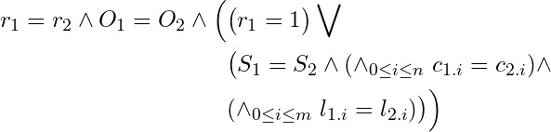
Checking … with Math
Storage
environment
(balance, nonces, …)
calldata buffer
(I, S, E)
Mathematical property:
P₁
P₂
same revert status
same returndata
reverted, OR…
r = revert flag O = return buffer S = result storage
n external calls
c_{1.0} = first call “hash” … c_{1.n}= last call “hash”
m logs emitted
l_{1.0} = first log “hash” … l_{1.m}= last log “hash”
(r₁, O₁, S₁,
[c_{1.0}, ..., c_{1.n}],
[l_{1.0} , ..., l_{1.m}])
(r₂, O₂, S₂,
[c_{2.0}, ..., c_{2.n}],
[l_{2.0} , ..., l_{2.m}])
Notes:
“After all, we can declare two 'mathematical' functions to be 'extensionally equal' if they produce the same output values on the same input values”

Slide 42
Checking … with Math
Storage
environment
(balance, nonces, …)
calldata buffer
(I, S, E)
Mathematical property:
P₁
P₂
Same storage
Same call “hashes”
(r₁, O₁, S₁,
[c_{1.0}, ..., c_{1.n}],
[l_{1.0} , ..., l_{1.m}])
(r₂, O₂, S₂,
[c_{2.0}, ..., c_{2.n}],
[l_{2.0} , ..., l_{2.m}])
Notes:
“After all, we can declare two 'mathematical' functions to be 'extensionally equal' if they produce the same output values on the same input values”

Slide 43
Checking … with Math
Storage
environment
(balance, nonces, …)
calldata buffer
(I, S, E)
Mathematical property:
P₁
P₂
Same log “hashes”
(r₁, O₁, S₁,
[c_{1.0}, ..., c_{1.n}],
[l_{1.0} , ..., l_{1.m}])
(r₂, O₂, S₂,
[c_{2.0}, ..., c_{2.n}],
[l_{2.0} , ..., l_{2.m}])
Notes:
“After all, we can declare two 'mathematical' functions to be 'extensionally equal' if they produce the same output values on the same input values”

Slide 44
“Symbolic” Instrumentation
v1 := calldataload(4)
// ...
v2 := call(tgt = r, amt = b, gas = g, inOffs = i, inSize = sz, ...) // ...
log3(t1, t2, t3, offs = i2, sz = sz2)
if(*) {
return(i = ret, sz = sz3) } else {
revert(i = rev, sz = sz4)
}
Notes:
“After all, we can declare two 'mathematical' functions to be 'extensionally equal' if they produce the same output values on the same input values”

Slide 45
“Symbolic” Instrumentation
Include hash of sent buffer
v1 := calldataload(4)
// ...
c_{i} := hash(r, b, hash(mem[i:sz]), hash(S))
v2 := call(tgt = r, amt = b, gas = g, inOffs = i, inSize = sz, ...) // ...
l_{j} := hash(t1, t2, t3, hash(mem[i2:sz2]))
log3(t1, t2, t3, offs = i2, sz = sz2)
if(*) {
r := 0, O := hash(mem[ret:sz3])
return(i = ret, sz = sz3) } else {
r := 1, O := hash(mem[rev:sz4])
revert(i = rev, sz = sz4)
}
“hash”* of current storage
(re-entrancy)
Effects of call soundly modeled
Injective, uninterpreted function
Most of the engineering
Notes:
“After all, we can declare two 'mathematical' functions to be 'extensionally equal' if they produce the same output values on the same input values”

Slide 46
“Symbolic” Instrumentation
l := [], c = [], call_idx = 0, log_idx = 0
v1 := calldataload(4)
// ...
c[call_idx++] := hash(r, b, hash(mem[i:sz]), hash(S))
v2 := call(tgt = r, amt = b, gas = g, inOffs = i, inSize = sz, ...) // ...
l[log_idx++] := hash(t1, t2, t3, hash(mem[i2:sz2]))
log3(t1, t2, t3, offs = i2, sz = sz2)
if(*) {
r := 0, O := hash(mem[ret:sz3])
return(i = ret, sz = sz3) } else {
r := 1, O := hash(mem[rev:sz4])
revert(i = rev, sz = sz4)
}
Notes:
“After all, we can declare two 'mathematical' functions to be 'extensionally equal' if they produce the same output values on the same input values”

Slide 47
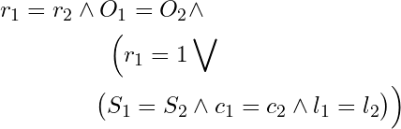
Checking with Instrumentation
(I, S, E)
Mathematical property:
P₁
P₂
How do you compare “all of storage”?
How do you symbolically compare lists?
(r₁, O₁, S₁,
c₁=[c_{1.0}, ..., c_{1.n}],
l₁=[l_{1.0} , ..., l_{1.m}])
(r₂, O₂, S₂,
c₂=[c_{2.0}, ..., c_{2.n}],
l₂=[l_{2.0} , ..., l_{2.m}])
Notes:
“After all, we can declare two 'mathematical' functions to be 'extensionally equal' if they produce the same output values on the same input values”

Slide 48

A Brief Digression on Solvers
Fun drinking game: take a drink whenever someone from Certora says “solver”
But, how are we using them, exactly?

Slide 49

Solvers: What do they do?
x = 2
y = 4
Roughly: take a mathematical formula, determines if it can be “satisfied” (hence “SAT” solver)
OR prove it can never be satisfied
x + 2 = y
x + 1 = x + 2

Slide 50
Solvers: For Verification?
function f(uint x) {
require(x > 4);
assert(x != 3);
}
Ask the SAT solver to “satisfy” the negation of your assertion
If it can, it “found” a way to violate your assertion
OR it has proven the negation of your assertion can’t happen
“Is there some possible value of x…
Nope!
∃x. x > 4 ⋀ x ==3
… that is greater than 4 and …
… and is equal to 3

Slide 51
How to compare lists (symbolically)
Can’t (unsat)
Solver
Pick any possible i…
assert l₁ = l₂
What we want to say “intuitively”
i = *
l₁[i] != l₂[i]
There is no index where the lists differ
… where the values at i are different
The lists are equal!

Slide 52
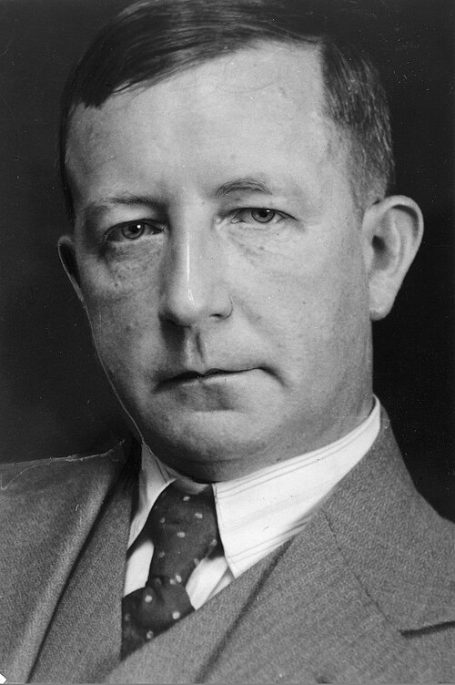
Skolemization
“Well known” technique from logic
Turns difficult queries logical formulae into simpler ones
So what?
Thorlaf Skolem

Slide 53
Checking with Instrumentation
(I, S, E)
Mathematical property:
P₁
P₂
✓
✓
How do you compare “all of storage”?
How do you symbolically compare lists?
(r₁, O₁, S₁,
c₁=[c_{1.0}, ..., c_{1.n}],
l₁=[l_{1.0} , ..., l_{1.m}])
(r₂, O₂, S₂,
c₂=[c_{2.0}, ..., c_{2.n}],
l₂=[l_{2.0} , ..., l_{2.m}])
Notes:
“After all, we can declare two 'mathematical' functions to be 'extensionally equal' if they produce the same output values on the same input values”

Slide 54
“Symbolic” Instrumentation
l := [], c = [], call_idx = 0, log_idx = 0
v1 := calldataload(4)
// ...
c[call_idx++] := hash(r, b, hash(mem[i:sz]), hash(S))
v2 := call(tgt = r, amt = b, gas = g, inOffs = i, inSize = sz, ...) // ...
l[log_idx++] := hash(t1, t2, t3, hash(mem[i2:sz2]))
log3(t1, t2, t3, offs = i2, sz = sz2)
if(*) {
r := 0, O := hash(mem[ret:sz3])
return(i = ret, sz = sz3) } else {
r := 1, O := hash(mem[rev:sz4])
revert(i = rev, sz = sz4)
}
“hash”* of current storage
(re-entrancy)
Notes:
“After all, we can declare two 'mathematical' functions to be 'extensionally equal' if they produce the same output values on the same input values”

Slide 55
Re-entrancy and External Calls
I
We assume that external calls are deterministic w.r.t. their inputs
Calldata, value, etc.
And “the environment”...
C
C
O

Slide 56
Re-entrancy and External Calls
P₁
P₂
We assume that external calls are deterministic w.r.t. their inputs
Calldata, value, etc.
And “the environment”...
…which includes the storage of the caller, i.e., P₁ and P₂
(I, S)
C
C
O

Slide 57
“Symbolic” Instrumentation
c₁ = [], call_idx₁ = 0
// ...
c₁[call_idx₁++] := hash(r1, b1, hash(mem[i:sz]), hash(S₁))
v1 := call(tgt = r1, amt = b1, gas = g1, inOffs = i, inSize = sz, ...) // ...
c₂ = [], call_idx₂ = 0
// ... c₂[call_idx₂++] := hash(r2, b2, hash(mem[i:sz]), hash(S₂))
v2 := call(tgt = r2, amt = b2, gas = g2, inOffs = i, inSize = sz, ...) // ...
assert c₁ = c₂
“Injective”, uninterpreted function
If the output of the functions are the same, the inputs MUST be the same
f(x) = f(y) ⇒ x = y
Notes:
“After all, we can declare two 'mathematical' functions to be 'extensionally equal' if they produce the same output values on the same input values”

Slide 58
“Symbolic” Instrumentation
f(x) = f(y) ⇒ x = y
f(x) != f(y) ⇒ x != y
c₁ = [], call_idx₁ = 0
// ...
c₁[call_idx₁++] := hash(r1, b1, hash(mem[i:sz]), hash(S₁))
v1 := call(tgt = r1, amt = b1, gas = g1, inOffs = i, inSize = sz, ...) // ...
c₂ = [], call_idx₂ = 0
// ... c₂[call_idx₂++] := hash(r2, b2, hash(mem[i:sz]), hash(S₂))
v2 := call(tgt = r2, amt = b2, gas = g2, inOffs = i, inSize = sz, ...) // ...
assert c₁ = c₂
“try to find difference in hashes”
“try to find difference in lists”
Notes:
“After all, we can declare two 'mathematical' functions to be 'extensionally equal' if they produce the same output values on the same input values”

Slide 59
“Symbolic” Instrumentation
f(x) != f(y) ⇒ x != y
c₁ = [], call_idx₁ = 0
// ...
c₁[call_idx₁++] := hash(r1, b1, hash(mem[i:sz]), hash(S₁))
v1 := call(tgt = r1, amt = b1, gas = g1, inOffs = i, inSize = sz, ...) // ...
c₂ = [], call_idx₂ = 0
// ... c₂[call_idx₂++] := hash(r2, b2, hash(mem[i:sz]), hash(S₂))
v2 := call(tgt = r2, amt = b2, gas = g2, inOffs = i, inSize = sz, ...) // ...
assert c₁ = c₂
“try to find difference in hash arguments”
“try to find difference in lists”
Notes:
“After all, we can declare two 'mathematical' functions to be 'extensionally equal' if they produce the same output values on the same input values”

Slide 60
“Symbolic” Instrumentation
f(x) != f(y) ⇒ x != y
c₁ = [], call_idx₁ = 0
// ...
c₁[call_idx₁++] := hash(r1, b1, hash(mem[i:sz]), hash(S₁))
v1 := call(tgt = r1, amt = b1, gas = g1, inOffs = i, inSize = sz, ...) // ...
c₂ = [], call_idx₂ = 0
// ... c₂[call_idx₂++] := hash(r2, b2, hash(mem[i:sz]), hash(S₂))
v2 := call(tgt = r2, amt = b2, gas = g2, inOffs = i, inSize = sz, ...) // ...
assert c₁ = c₂
“try to find difference in hash arguments”
Find difference in storage… … which is a list
“try to find difference in lists”
Notes:
“After all, we can declare two 'mathematical' functions to be 'extensionally equal' if they produce the same output values on the same input values”

Slide 61
“Symbolic” Instrumentation
c₁ = [], call_idx₁ = 0
// ...
repr₁ = S₁[f(call_idx₁)]
c₁[call_idx₁++] := hash(r1, b1, hash(mem[i:sz]), hash(S₁))
v1 := call(tgt = r1, amt = b1, gas = g1, inOffs = i, inSize = sz, ...) // ...
c₂ = [], call_idx₂ = 0
// ...
repr₂ = S₂[f(call_idx₂)] c₂[call_idx₂++] := hash(r2, b2, hash(mem[i:sz]), hash(S₂))
v2 := call(tgt = r2, amt = b2, gas = g2, inOffs = i, inSize = sz, ...) // ...
assert c₁ = c₂
Pick an arbitrary index, but that index is the same at both calls
Notes:
“After all, we can declare two 'mathematical' functions to be 'extensionally equal' if they produce the same output values on the same input values”

Slide 62
“Symbolic” Instrumentation
c₁ = [], call_idx₁ = 0
// ...
repr₁ = S₁[f(call_idx₁)]
c₁[call_idx₁++] := hash(r1, b1, hash(mem[i:sz]), repr₁)
v1 := call(tgt = r1, amt = b1, gas = g1, inOffs = i, inSize = sz, ...) // ...
c₂ = [], call_idx₂ = 0
// ...
repr₂ = S₂[f(call_idx₂)] c₂[call_idx₂++] := hash(r2, b2, hash(mem[i:sz]), repr₂)
v2 := call(tgt = r2, amt = b2, gas = g2, inOffs = i, inSize = sz, ...) // ...
assert c₁ = c₂
Notes:
“After all, we can declare two 'mathematical' functions to be 'extensionally equal' if they produce the same output values on the same input values”

Slide 63
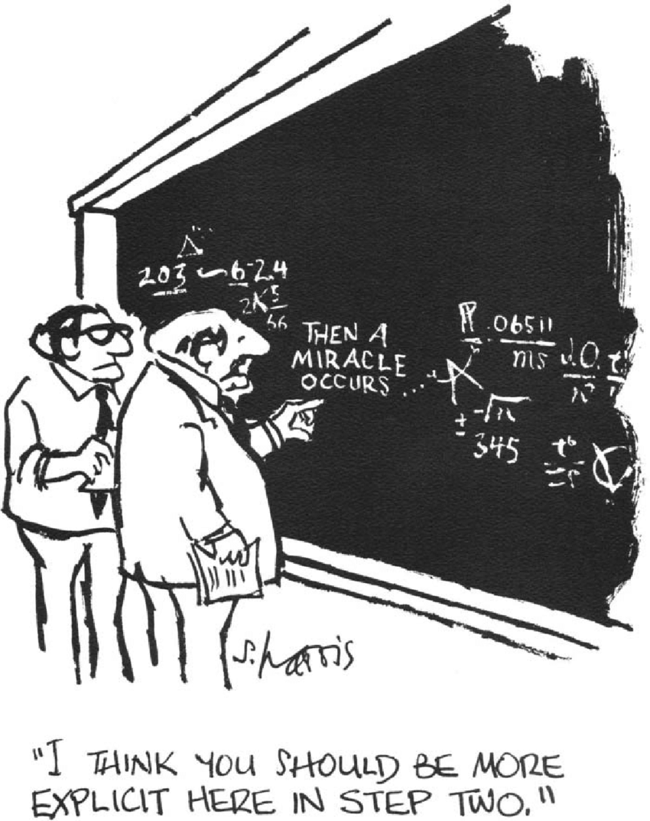

Glossed Over…
Details of buffer hashing
Model of external calls
…
(Concord tech report)

Slide 64
Limitations
Contracts MUST use the exact same storage layout
Must have the same ABI
Assumes no “reflection” by other actors (extcodesize, extcodehash, gasleft, etc.)

Slide 65
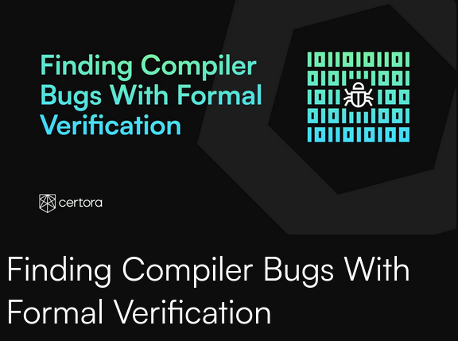
Success Stories
Concord is crucial to our verified rewriting
Useful in other contexts: verifying compiler optimizations
To wit: it uncovered a bug in Vyper’s experimental compilation pipeline

Slide 66
Summary: Concord
…
…
Instrument code to record side effects
Use symbolic reasoning of Certora Prover to check results/side effects are always the same
Next: AI Hype-train
Concord
…
…
Formally verifies whether two contracts are equivalent

Slide 67
Concordance: The Details

Slide 68
Concordance: Feedback Loop
(original)
(original)
.SOL
LLM
.SOL
Concord
Explanation
(simplified)
(simplified)
Prompt
.SOL
.SOL

Slide 69
Explaining Explanations
Certora Prover uses SMT solvers
These produce a concrete counterexample demonstrating a violation
Analyze counterexample; extract description of events

Slide 70
Explaining Explanations
function safeTransferFrom(
address token,
address from,
address to,
uint256 amount
) internal {
assembly {
let m := mload(0x40)
mstore(0x60, amount)
mstore(0x40, to)
mstore(0x2c, shl(96, from))
mstore(0x0c, 0x23b872dd000000000000000000000000)
let success := call(gas(), token, 0, 0x1c, 0x64, 0x00, 0x20)
if iszero(and(eq(mload(0x00), 1), success)) {
if iszero(
lt(
or(iszero(extcodesize(token)), returndatasize()),
success
)
) {
mstore(0x00, 0x7939f424)
revert(0x1c, 0x04)
}
}
mstore(0x60, 0)
mstore(0x40, m)
}
}
function safeTransferFrom(
address token,
address from,
address to,
uint256 amount
) internal {
(bool success, bytes memory returndata) = token.call(
abi.encodeWithSelector(0x23b872dd, from, to, amount)
);
// Check if the call succeeded and returned true (1)
if (success && returndata.length >= 32 && abi.decode(returndata, (bool))) {
return;
}
// Allow calls to contracts that don't return values (non-standard tokens)
if (success && token.code.length > 0 && returndata.length == 0) {
return;
}
// All other cases should revert with TransferFromFailed
revert TransferFromFailed;
}

Slide 71
Explaining Explanations
There were 1 call(s) prior to this event:
External call to 0xffffffffffffffffffffffffffffffffffffffff with eth: 0
The calldata buffer was:
23b872dd00000000000000000000000000000000000000000000ffffffffffffffffffffffffffffffffffffffff00000000000000000000000000000000
The callee codesize was chosen as: 1
The call result was:
A successful return
With a buffer of length: 4294967295
The returned buffer model is:
0000000000000000000000000000000000000000000000000000000000000002... missing 4294967263 more bytes
The methods performed different actions.
In SafeTransferFromHarness.safeTransferFromExternal(address,address,address,uint256):
! The call reverted
Event Context:
No additional context information
The raw buffer used in the event was:
7939f424
In SafeTransferFromRewriteHarness.safeTransferFromExternal(address,address,address,uint256):
! The call reverted
Event Context:
No additional context information
The raw buffer used in the event was:
! Empty
Original explicitly reverts with “TransferFromFailed()”
Not a valid encoding of a bool!
abi.decode reverts with empty buffer

Slide 72
LLM Fix
if (success && returndata.length >= 32 && abi.decode(returndata, (bool))) {
return;
}
if (success && returndata.length >= 32 && uint256(bytes32(returndata)) == 1) {
return;
}

Slide 73
Concordance: Not Simply Simplification
(original)
(original)
.SOL
LLM
.SOL
Concord
Explanation
(simplified)
(simplified)
Prompt
.SOL
“Please simplify the following code …”
.SOL

Slide 74
Concordance: Not Simply Simplification
(original)
(original)
.SOL
LLM
.SOL
Concord
Explanation
(simplified)
(simplified)
Prompt
.SOL
“Please optimize the following code …”
.SOL

Slide 75
Concordance: Not Simply Simplification
(original)
(original)
.SOL
LLM
.SOL
Concord
Explanation
(simplified)
(simplified)
Prompt
.SOL
“Please port the following code …”
.SOL

Slide 76
Concordance: Not Simply Simplification
(original)
(original)
.SOL
LLM
.SOL
Concord
Explanation
(simplified)
(simplified)
Prompt
.SOL
“Please refactor the following code …”
.SOL

Slide 77

It’s open source!
(github link)

Slide 78
Thanks!
Questions?

Slide 81
Appendix
Brand Assets

Slide 82





The Certora Static Code Analysis:
Exhaustive defect finding
Proofs that the invariants hold forever
Invariants
Unknown
Timeout
Code
A hard to find behavior which violates the invariants

Slide 83

Certora Prover Architecture
Sol C
Decompile
.SOL
.EVM
Mitigating SMT complexity
Report
.TAC
Compile
VC generation
SMT Solve
Analyze
.SPEC
.SMT2
.SMT2
Correctness preserving transformation

Slide 84


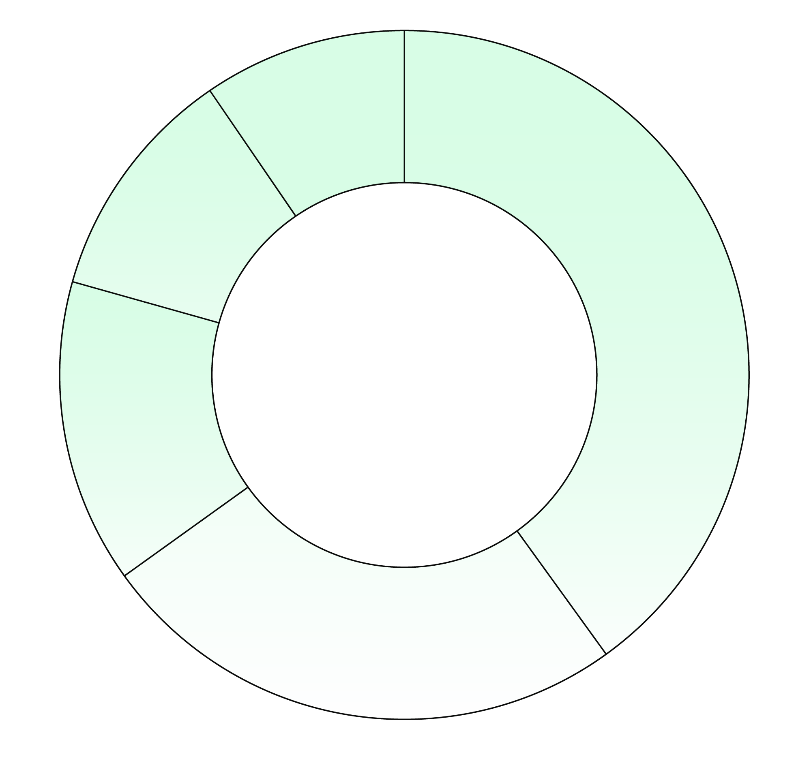



Certora Today
$2B
+2 Million
$2B
Solidity lines automatically verified
$8B
$20B
15,000
$3B
Protected TVL
Runs per month
100
$5B
DeFi hacks prevented

Slide 85

We thank all contributors who made this release possible. Special thanks goes to @johnadtoman of @Certorainc for reporting the inlines assembly memory side effects bug!
Solidity @solidity_lang

Slide 86


Slide 87














Slide 88














Slide 89



















